Slide 1
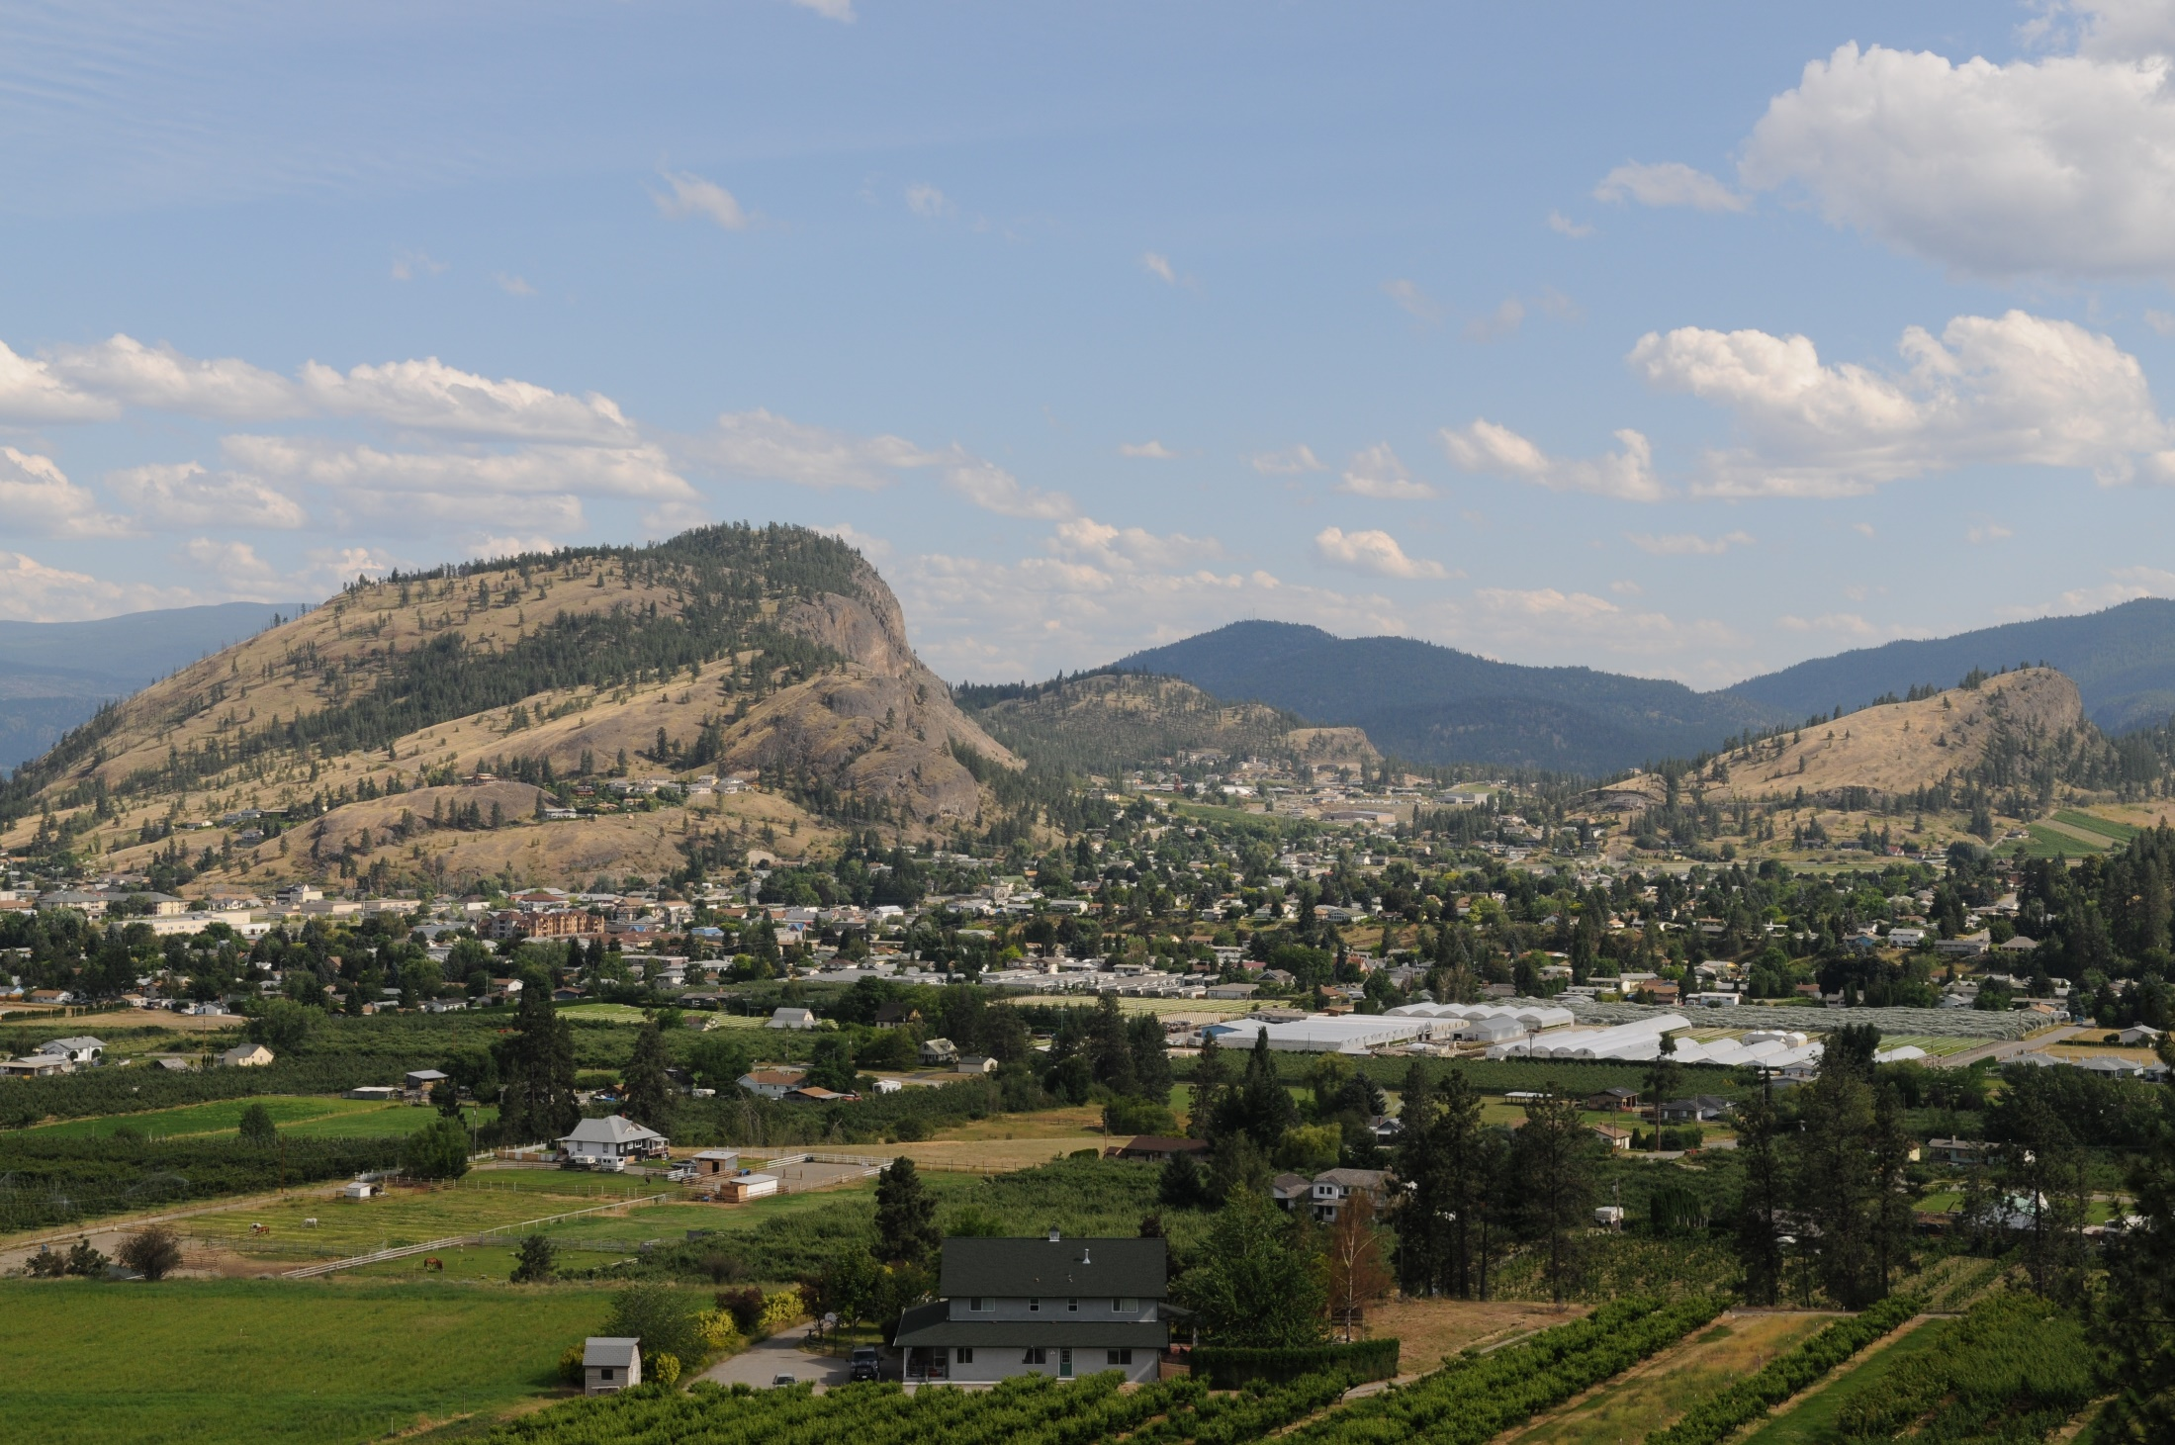
2015 Financial Plan

Slide 2
PROCESS
Staff began work on this budget in September
4 meetings including today are scheduled – Jan 26, 28 and Feb 2 and further meetings will be added as needed
At the start of each meeting, time is available for delegations and questions from the public
Beginning January 26, the Directors will have a brief presentation on their departments and be available for questions
Following the department presentations, Council will provide guidance on increases in property taxes and user fees and the discretionary spending funds will be revised as needed

Slide 3
PROCESS
Staff will provide a recommendation of the discretionary spending projects for Council’s consideration
At the conclusion of the review meetings, the five year financial plan bylaw will be introduced
Amendment of the bylaw and setting of the tax rates – April 27 (tentative date for first 3 readings)
Adoption of the tax rates bylaw and the 5 year plan – May 11

Slide 4
Introduction
Financial plan has no increases to the service levels of 2014. Price changes have been reflected
No increases in property taxes or user fees other than the expected Fortis increase of 3.5%. The purchase of power is about 75% of the costs in the electric fund. The budget has an annual 2.625% increase in electric rates (3.5% times 75%)

Slide 5
Council Direction
Core budget funding level
Discretionary budget funding level
Increases to property taxation and user fees
Allocation of the administration costs to the utility funds
Identification of a funding level for fleet replacement
Increases in the administration charge and the fleet charge rates will impact all funds

Slide 8
2015 Budget Facts
Staffing:
11 Management/3 Exempt $1.3m 14 FTE
60 CUPE/5 IBEW $4.2m 65 FTE
Debt:
December 31, 2014 $25.6m
Debt servicing costs $ 3.1m
% of revenue – 25% cap 12.6%
Water Separation borrowing $ 1.8m
Water Separation servicing costs (2017) $ .4m

Slide 9
Revenue
 | General | Water | Sewer | Electric
Budget 2015 | 11,587,347 | 4,391,003 | 2,437,167 | 10,118,585
Budget 2014 | 11,019,035 | 4,373,649 | 2,423,542 | 9,976,303
Change | 568,312 | 17,354 | 13,625 | 142,282
% | 5.16 | .40 | .56 | 1.43
General
Taxes – non market change (growth) and roll changes $ 81,000
Provincial grants $ 141,000
Increase transfer from Electric fund for lighting $ 334,300
$ 556,300
Electric
Electric rates increase $ 252,300
Developer paid work decrease $(105,000)
$ 147,300
Note: one time increase in revenue in Electric fund from change in billing cycle will not impact 2015.

Slide 10
PROPERTY TAXATION
2014 General Property Tax Levy | $6,664,951
HISTORICAL TAX INCREASES
2014 – 2.0% | 2013 – 2.0% | 2012 – 1.5%
2011 – 1.0% | 2010 – 2.5% | 2009 – 2.2%
2014 Tax Ratios (Multiple)
Class 2 Utilities | 7.029
Class 5 Light Industry | 1.951
Class 6 Business/Other | 2.705
Class 8 Recreation/Non Profit | 1.951
Class 9 Farm | 2.839
2014 Assessment | 2014 Taxation
Residential 93% | 83%
Business 5% | 13%
Other 2% | 4%

Slide 11
Expenditure
 | General | Water | Sewer | Electric
Budget 2015 | 10,903,614 | 3,985,509 | 2,344,913 | 9,657,742
Budget 2014 | 10,485,411 | 4,071,221 | 2,391,648 | 9,377,455
Change | 418,203 | (85,712) | (46,735) | 280,287
% | 4.0 | (2.11) | (1.95) | 2.99
The shift in management responsibility for Parks Maintenance to the Works and Utilities department has not been reflected in the budget or financial statements as this impacts internal reporting not historical costs.
The 2015 labour budgets reflect the 2014 budget and known increases. In the tax rates setting version of the budget, there will be further reallocation of the labour budgets to better reflect where the work happens.
The shift of the lighting costs from the Electric Fund to the General Fund is $334,300 – 3.2% of the 2014 budget for the general fund leaving $84,000, a .8% increase attributed to other expenses

Slide 12
Funding
 | General | Water | Sewer | Electric
Discretionary Funds available | 683,732 | 388,140 | 99,491 | 318,561
1% increase | 67,500 | 19,700 | 8,900 | 96,275
2013 Accumulated Surplus | 585,184 | 181,479 | 48,017 | 22,957
Reserve Accounts-projected | 2,107,078 | 37,237 | 5,527 | 750,454
Statutory Funds | 613,898 | 17,509 | 730,540 | 0
2015 Discretionary projects | 2,184,918 | 482,870 | 546,000 | 411,000
Future Discretionary projects to 2019 | 6,502,854 | 4,236,370 | 1,280,572 | 1,163,444
Community Works Funds (Gas Tax) on hand $541,933
Annual Funding $503,183

Slide 13
Administration Charge
 | General revenue | Water expense | Sewer expense | Electric expense
Budget 2015 | 366,000 | 120,000 | 54,000 | 192,000
Proposed | 1,108,000 | 292,000 | 177,000 | 639,000
Change | 742,000 | 172,000 | 123,000 | 447,000
Current transfer to general fund |  |  |  | 600,000
Drop the transfer to general fund from electric | 447,000
Net impact on fund | 295,000 | (172,000) | (123,000) | 0
Council direction sought on increasing the administration charge in water and sewer

Slide 14
Fleet
 | Net Fleet Operations
Budget 2015 – net cost | $129,344
Budget 2014 – net cost | $100,405
Actual Net Cost 2013 | $258,201
Actual Net Cost 2012 | $114,359
No increase to reserve funds on hand in any of these years
Reserve account $567,000
Estimated cost to renew the fleet $11 million
Need to undertake a full review of all fleet vehicles - cradle to grave costs, expected life and charge out rates
Current fleet charges in the budget – not including leases Increase
General $416,150 73% $94,500
Water $ 54,470 10% $12,900
Sewer $ 27,450 5% $ 6,450
Electric $ 67,750 12% $15,500

